Slide 1
Artificial Intelligence
4. Knowledge Representation
Course V231
Department of Computing
Imperial College, London
© Simon Colton

Slide 2
Representation Representation Representation
Think about knowledge, rather than data in AI
Facts
Procedures
Meaning
  Cannot have intelligence without knowledge
Always been very important in AI
Choosing the wrong representation
  Could lead to a project failing
Still a lot of work done on representation issues

Slide 3
Representations for
Problem solving techniques
For certain problem solving techniques
  The “best” representation has already been worked out
  Often it is an obvious requirement of the technique
  Or a requirement of the programming language (e.g., Prolog)
Examples:
  First order theorem proving (first order logic)
  Inductive logic programming (logic programs)
  Neural networks learning (neural networks)
But what if you have a new project?
  What kind of general representations schemes are there?

Slide 4
Four General Representation Types
Logical Representations
Semantic Networks
Production Rules
Frames

Slide 5
4.1 Logical Representations
What is a Logic?
Lay down some concrete communication rules
  In order to give information to agents, and get info
    Without errors in communication (or at least, fewer)
Think of a logic as a language
  Many ways to translate from one language to another
Expressiveness
  How much of natural language (e.g., English)
    We are able to translate into the logical language
Not to be confused with logical reasoning
  “Sherlock Holmes used pure logic to solve that…”
  This is a process, not a language

Slide 6
Syntax and Semantics of Logics
Syntax
  How we can construct legal sentences in the logic
  Which symbols we can use (English: letters, punctuation)
  How we are allowed to write down those symbols
Semantics
  How we interpret (read) sentences in the logic
  i.e., what the meaning of a sentence is
Example: “All lecturers are six foot tall”
  Perfectly valid sentence (syntax)
  And we can understand the meaning (semantics)
  This sentence happens to be false (there is a counterexample)

Slide 7
Propositional Logic
Syntax
  Propositions such as P meaning “it is wet”
  Connectives: and, or, not, implies, equivalent
  Brackets, T (true) and F (false)
Semantics
  How to work out the truth of a sentence
    Need to know how connectives affect truth
    E.g., “P and Q” is true if and only if P is true and Q is true
    “P implies Q” is true if P and Q are true or if P is false
  Can draw up truth tables to work out the truth of statements

Slide 8
First Order Predicate Logic
More expressive logic than propositional
  And one we will use a lot in this course
    Later lecture all about first order predicate logic
Syntax allows
  Constants, variables, predicates, functions and quantifiers
So, we say something is true for all objects (universal)
  Or something is true for at least one object (existential)
Semantics
  Working out the truth of statement
    This can be done using rules of deduction

Slide 9
Example Sentence
In English:
  “Every Monday and Wednesday I go to John’s house for dinner”
In first order predicate logic:
X ((day_of_week(X, monday)
day_of_week(X, weds))
(go_to(me, house_of(john)
eat(me, dinner))).
Note the change from “and” to “or”
  Translating is problematic

Slide 10
Higher Order Predicate Logic
More expressive than first order predicate logic
Allows quantification over functions and predicates, as well as objects
For example
  We can say that all our polynomials have a zero at 17:
  f (f(17)=0).
Working at the meta-level
  Important to AI, but not often used

Slide 11
Other Logics
Fuzzy logic
  Use probabilities, rather than truth values
Multi-valued logics
  Assertions other than true and false allowed
    E.g., “unknown”
Modal logics
  Include beliefs about the world
Temporal logics
  Incorporate considerations of time

Slide 12
Why Logic is a Good Representation
Some of many reasons are:
  It’s fairly easy to do the translation when possible
  There are whole tracts of mathematics devoted to it
  It enables us to do logical reasoning
  Programming languages have grown out of logics
    Prolog uses logic programs (a subset of predicate logic)

Slide 13
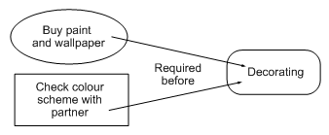

Semantic Networks
Logic is not the only fruit
Humans draw diagrams all the time, e.g.,
  E.g. causal relationships:
  And relationships between ideas:

Slide 14
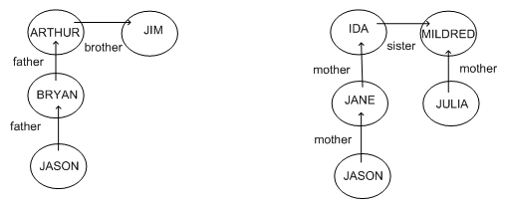
Graphical Representations
Graphs are very easy to store inside a computer
For information to be of any use
  We must impose a formalism on the graphs
  Jason is 15, Bryan is 40, Arthur is 70, Jim is 74
  How old is Julia?

Slide 15
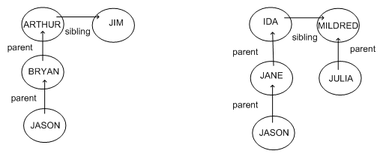
Better Graphical Representation
Because the formalism is the same
  We can guess that Julia’s age is similar to Bryan’s
Limited the syntax to impose formalism

Slide 16
Semantic Network Formalisms
Used a lot for natural language understanding
  Represent two sentences by graphs
    Sentences with same meaning have exactly same graphs
Conceptual Dependency Theory
  Roger Schank’s brainchild
  Concepts are nodes, relationships are edges
  Narrow down labels for edges to a very few possibilities
  Problem:
    Not clear whether reduction to graphs can be automated for all sentences in a natural language

Slide 17
Conceptual Graphs
John Sowa
Each graph represents a single proposition
Concept nodes can be:
  Concrete (visualisable) such as restaurant, my dog spot
  Abstract (not easily visualisable) such as anger
Edges do not have labels
  Instead, we introduce conceptual relation nodes
Many other considerations in the formalism
  See Russell and Norvig for details

Slide 18
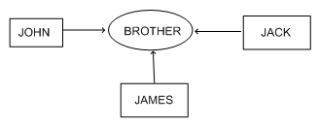
Example Conceptual Graph
Advantage:
  Single relationship between multiple concepts is easily representable

Slide 19
Production Rule Representations
Consists of <condition,action> pairs
Agent checks if a condition holds
  If so, the production rule “fires” and the action is carried out
  This is a recognize-act cycle
Given a new situation (state)
  Multiple production rules will fire at once
  Call this the conflict set
  Agent must choose from this set
    Call this conflict resolution
Production system is any agent
  Which performs using recognize-act cycles

Slide 20
Example Production Rule
As reported in Doug Lenat’s PhD thesis
102. After creating a new generalization G of Concept C
  Consider looking for non-examples of G
This was paraphrased
  In general, we have to be more concrete
    About exactly when to fire and what to do

Slide 21
Frame Representations
Information retrieval when facing a new situation
  The information is stored in frames with slots
  Some of the slots trigger actions, causing new situations
Frames are templates
  Which are to be filled-in in a situation
  Filling them in causes an agent to
    Undertake actions and retrieve other frames
Frames are extensions of record datatype in databases
  Also very similar to objects in OOP

Slide 22
Flexibility in Frames
Slots in a frame can contain
  Information for choosing a frame in a situation
  Relationships between this and other frames
  Procedures to carry out after various slots filled
  Default information to use where input is missing
  Blank slots - left blank unless required for a task
  Other frames, which gives a hierarchy

Slide 23
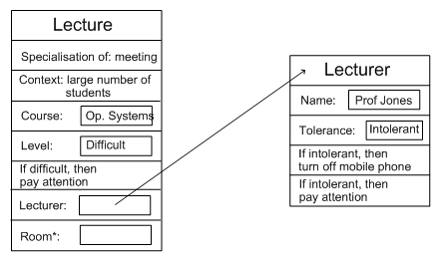
Example Frame

